Slide 1

CUBEINATOR
BY: Adharsh Ramakrishnan and Akash Chandrashekar

Slide 2
Planning and Development
We made a game to increase the knowledge of FBLA to people
This game is a fun and easy way to increase your knowledge by answering questions, when you finish levels.
This game will help people get to know more about FBLA, so there can be more future business leaders, and that will pioneer our future.
This is important because this will help educate up incoming students, that want to do something in the business field.
We were inspired to do this because we wanted to make a fun way to understand FBLA concepts, ideas and to get more people to join FBLA.

Slide 3
This is a rough estimate

Slide 4


Software Platforms Used
Game Developing Software: Unity
Scripting Software: Visual Studio
Main Scripting Language: C Sharp
PowerPoint Platform: Microsoft PowerPoint
Quiz Text: Material UI

Slide 5
Main Assets/Scenes
Main Menu Scene
Level 1 Scene
Level 2 Scene
Level 3 Scene
Level 4 Scene
Credits Scene
Quiz Level Scene

Slide 6
Scripts
Credits
End Trigger
Follow Player
Game Manager
Level Complete
Main Menu
Player Collision
Player Movement
Score
Question
Quiz Manager

Slide 7
Quiz Scripts

Slide 8
Player Movement

Slide 9
How to play the game
You are a cube and you have to dodge the obstacles
If you hit an obstacle or fall off the edge, then you will restart
Once you make it to the end of the level, then random FBLA questions will display and you have to answer them.
Once you answer the questions, you will be transitioned into the next level. Once you make it past all the levels, then a end credits scene will appear, in which you can quit the game

Slide 10
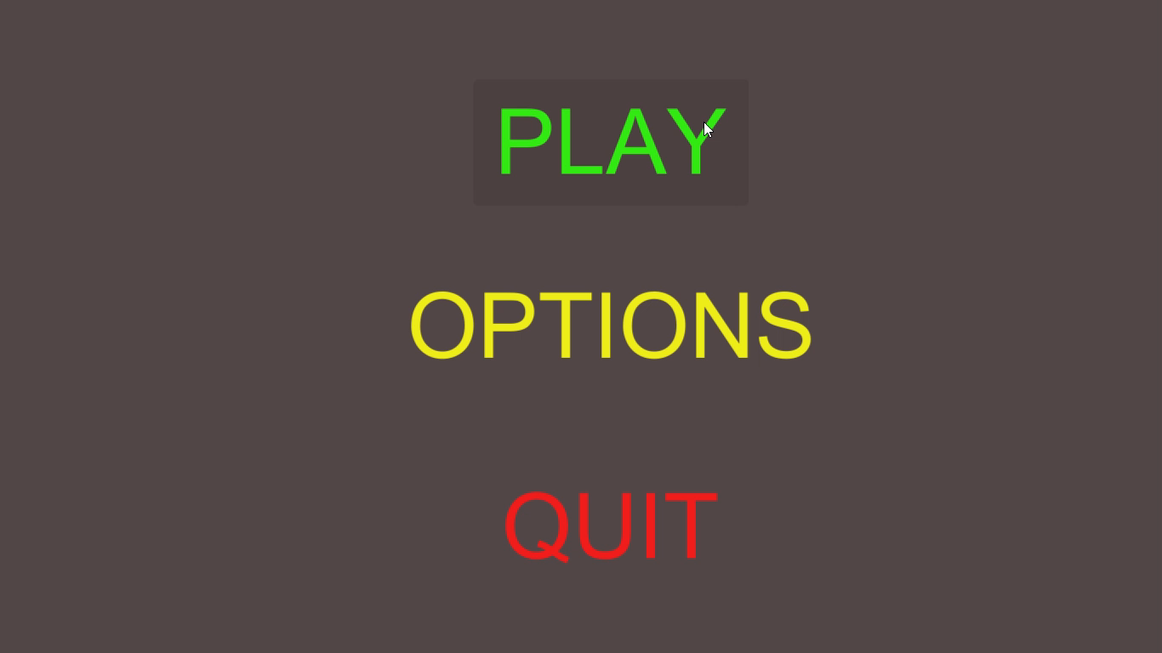
THE GAME

Slide 11
Player

Slide 12
QUIZ

Slide 13
End Credits Scene

Slide 14
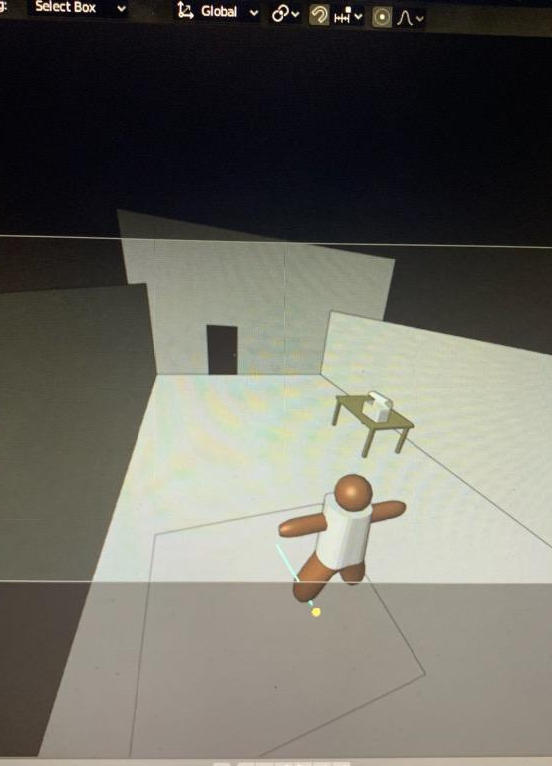
The original game
This was the original game , it was created in Blender and the code was supposed to be written in Python. The original game was made around the theme about escaping the house, you go around collect clues and answering questions in order to escape, although unfortunately due to inexperience and a lack of time it didn’t make it, but we are planning to bring it to nationals if you will give us the opportunity.

Slide 15
THANK YOU
We would like to thank you today for giving us this opportunity to create a game to increase the students joining FBLA.
We would like to thank you for giving us this experience to learn more about game development and coding.
Last of all, we would like to thank you for the time that you have given us to show our game.

